Slide 1

The Amsterdam Project
Short-term rentals in Amsterdam
Alessandro Mazzoni | Katja Galyuk | Mafalda Fragoso
Ironhack Data Analytics Bootcamp 06/03/2020

Slide 2
Table of Contents
Goals of the project
Data
Data cleaning
Data analysis
Main insights
Learnings & Improvements

Slide 3
GOALS OF THE PROJECT
Research question
How does the proximity to restaurants and nightlife venues impact the price of short-term rentals of Airbnb in Amsterdam?
Hypothesis
The higher the number of venues in close proximity to a property, the higher is the price per night of the property.

Slide 4
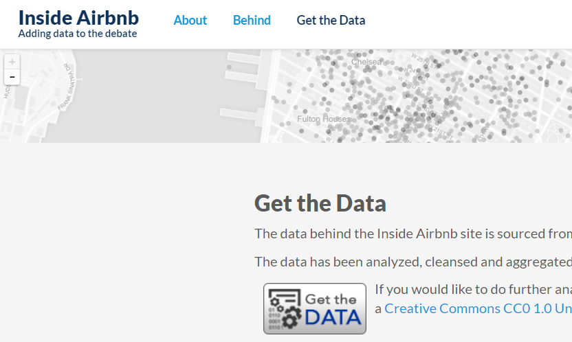
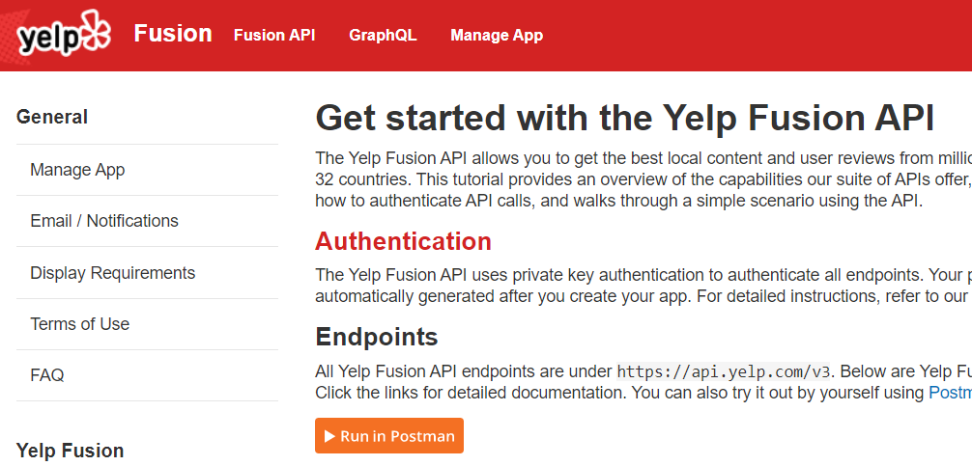
DATA
We have used two data sets to obtain our data
Listings of Airbnb rental apartments
Restaurants and nightlife venues
Data obtained from Inside Airbnb website
Data in CSV format with detailed listings data for Amsterdam including price per night, latitude, longitude, among others
Data obtained from Yelp Fusion API
We imported to Python the requests library to make a Get Request to the API
Restaurants: restaurants, cafes
Nightlife venues: bars, clubs

Slide 5
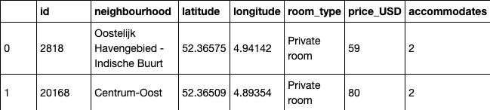
DATA CLEANING
Step 1: selecting the relevant columns and rows
Data set Airbnb 1 : id, neighbourhood, latitude, longitude, room_type, price
Data set Airbnb 2 : id, accommodates
Merge the two data sets
Checking for missing values
Checking for the number of duplicates
Checking the low variance
Checking the data types of columns
(20025, 16)

Slide 6
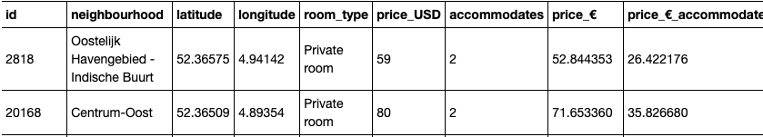
DATA CLEANING
Step 2: adjusting the price column
Rename the columns price to price_USD
Creating the columns price_€ (price_USD * exchange rate(0.895667))
Creating the columns price_€_accommodates (price_€ /accommodates)
Remove outlier (price between 30 and 900)
(19903, 9 )

Slide 7
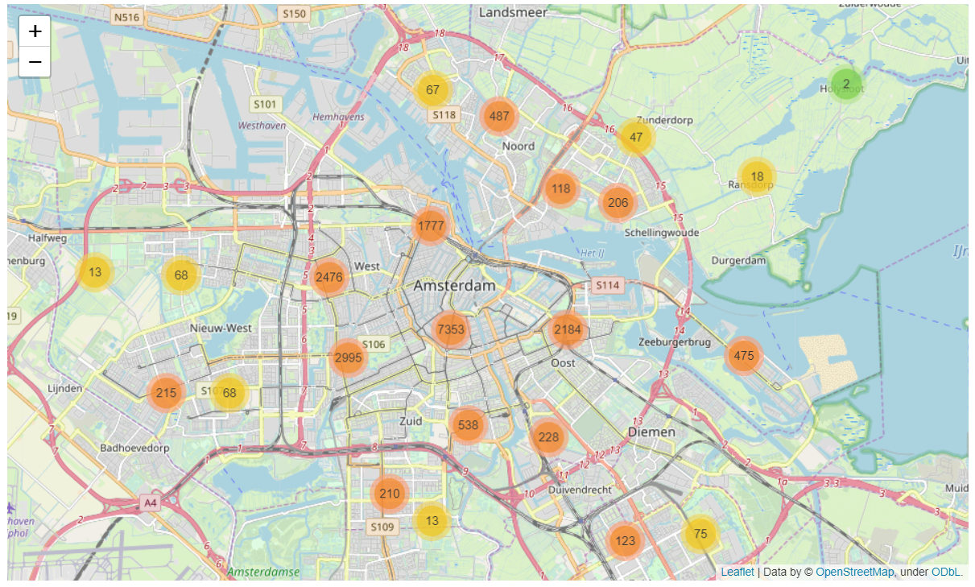
DATA ANALYSIS
We analyzed 19.903 rental apartments in Amsterdam from Airbnb
Neighbourhoods with the most listings are: Centrum, De Baarsjes and The Pijp

Slide 8
DATA ANALYSIS
The neighbourhoods with the highest number of properties have a higher average price per person
Total avg price: 141€/night
Total avg price/person: 51/night

Slide 9
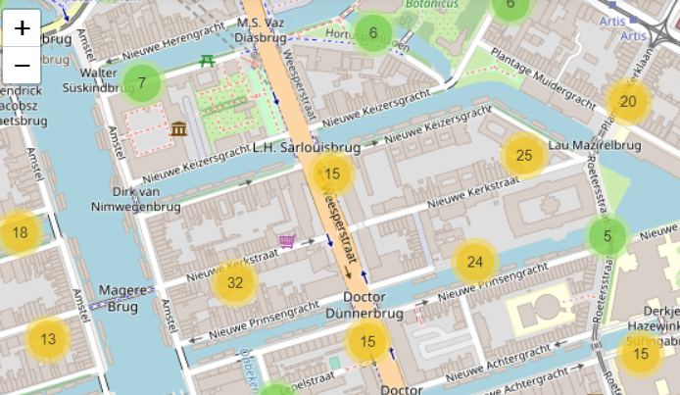
DATA ANALYSIS
We selected four neighbourhoods to map how many venues are within a radius of 200 meters from each property
Radius 200m
Property
Comparison within each neighbourhood: no correlation was found inside each neighbourhood between the location of the property and the venues nearby
Comparison between neighbourhoods: from the sample that we have collected, we can conclude that the neighbourhoods with the higher average number of venues nearby have the higher average prices

Slide 10
MAIN FINDINGS
Hypothesis: The higher the number of venues in close proximity to a property, the higher is the price per night of the property.
No relation was found between the price of a short term rental property and the number of venues in the proximity
Additional findings:
The neighbourhoods with the higher average number of venues nearby have the higher average prices

Slide 11
LIMITATIONS AND IMPROVEMENTS
Limitations
Improvements
Very limited information about the square meters of each apartment
Maximum number of calls we could make on the basic Yelp account
Extend the research to all neighbourhoods of Amsterdam
Explore other factors impacting the rental prices

Slide 12
Thank you!

Slide 13
Code

Slide 14
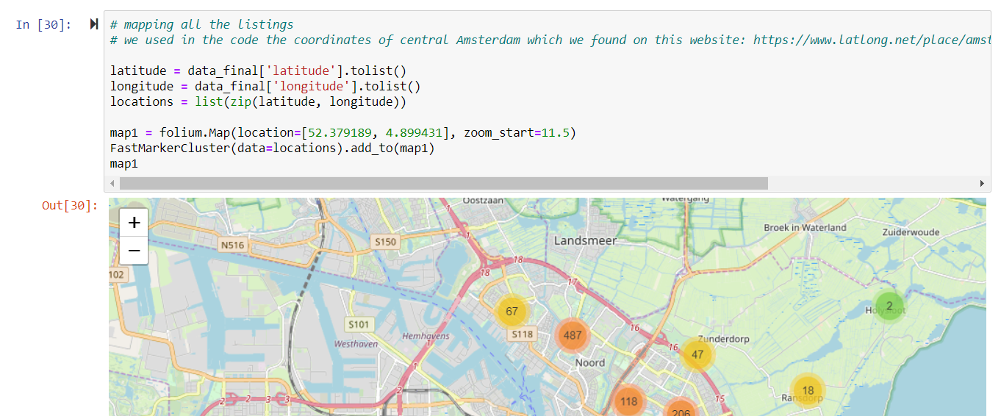
CODE
Mapping all the listings

Slide 15
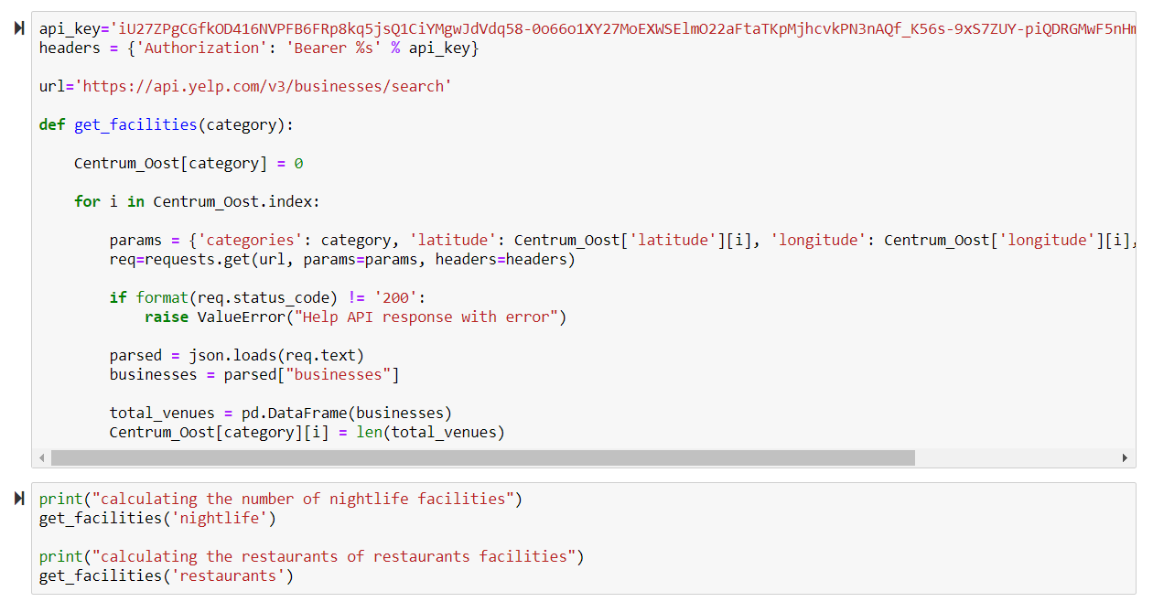
CODE
Working with Yelp API

